Slide 1

WebNavigator-AI-Agent
Team WONDER GIRLS – HacXLerate HackathonSeptember 2025

Slide 2





Team WONDER GIRLS
LLM Integration Lead
Browser Automation
Data Engineering
Advanced planning algorithms and natural language processing
Playwright integration and web scraping architecture
Extraction, cleaning, and structured output generation
Frontend & UX
Testing & Performance
Intuitive interface design and user experience optimization
Quality assurance and system optimization
What's Next
Voice command integration for hands-free operation
Support for 100+ e-commerce and research sites
Mobile app launch with offline synchronization

Slide 3

Manual Web Research Is Broken
PROBLEM STATEMENT:
“Browsing and re the web for tasks like ‘find the best laptop under 50,000’ is manual repetitive—requiring searches, comparisons, stock checks, and data compilation. Current AI assistants give answers but cannot execute such multi-step workflows in a real browser.”
SOLUTION:
Our AI-powered Web Navigator turns natural language into goal-oriented web journeys. Using a local LLM, it plans and automates browsing, extracts data, and delivers both human-readable summaries and structured outputs (CSV/JSON).
.

Slide 4




Meet Your Digital Research Partner
"Find top 5 laptops under ₹50k, compare specs, check Amazon/Flipkart stock, and send me a CSV"
AI Plans Journey
Understands your request and creates execution strategy
Automates Browsing
Visits multiple sites, extracts data, compares options
Delivers Results
Human summary + structured data ready for analysis

Slide 5




What Makes Us Different
Natural Language Input
Multi-Site Automation
Just talk normally - no technical skills or complex commands needed. Our AI understands conversational requests.
Simultaneously visits Amazon, Flipkart, news sites, and comparison platforms to gather comprehensive data.
Dual Output Format
Offline-Ready Design
Get both quick human-readable summaries and structured CSV/JSON files ready for spreadsheet analysis.
Works reliably even with poor internet connectivity using local LLM processing and smart caching.

Slide 6
Simple Flow: Command to Results
01
02
User Instruction
Local LLM Processing
Natural language request input
Ollama/LLaMA analyzes and plans
03
04
Task Orchestration
Browser Automation
Breaks down into executable steps
Playwright controls web browsing
05
06
Data Extraction
Dual Output Delivery
Structured information gathering
Summary + CSV/JSON export

Slide 7

Our Technology Toolkit
Brain
Memory
Local LLMOllama + LangChain for intelligent task planning and natural language understanding
SQLite DatabaseEfficient data storage and retrieval for structured information management
Hands
Interface
PlaywrightAutomated browser control for seamless web navigation and data extraction
React FrontendSimple, intuitive web interface powered by Python FastAPI backend

Slide 8
Real-World Impact & Time Savings
45-60
<2
95%
Minutes Manual Process
Minutes With Our Agent
Time Saved
Traditional research time
Automated completion time
Efficiency improvement
Shoppers
Researchers
Business Teams
Compare products in 1 minute vs. 1 hour of manual browsing across multiple e-commerce platforms
Auto-collect and structure data from 10+ sources simultaneously for comprehensive analysis
Generate detailed competitor reports and market analysis instantly with structured outputs

Slide 9

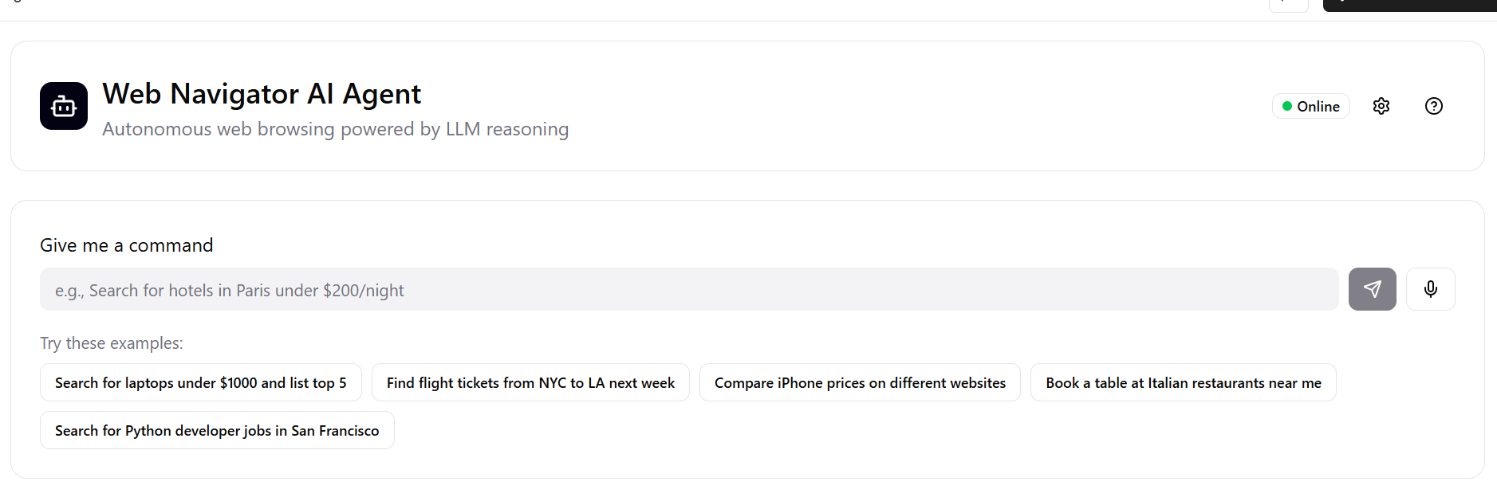
See It In Action
Sample Task: "Find 3 best smartphones under ₹20k, check battery life, compare Flipkart/Amazon prices, export CSV"
Human Summary
"Best battery: Samsung M15 (6,000mAh). Best value: Redmi 13C (₹12,999). Both in stock on Flipkart with fast delivery available."
Structured Output
Complete CSV with phone specs, prices, availability, and ratings across platforms ready for analysis.

Slide 10
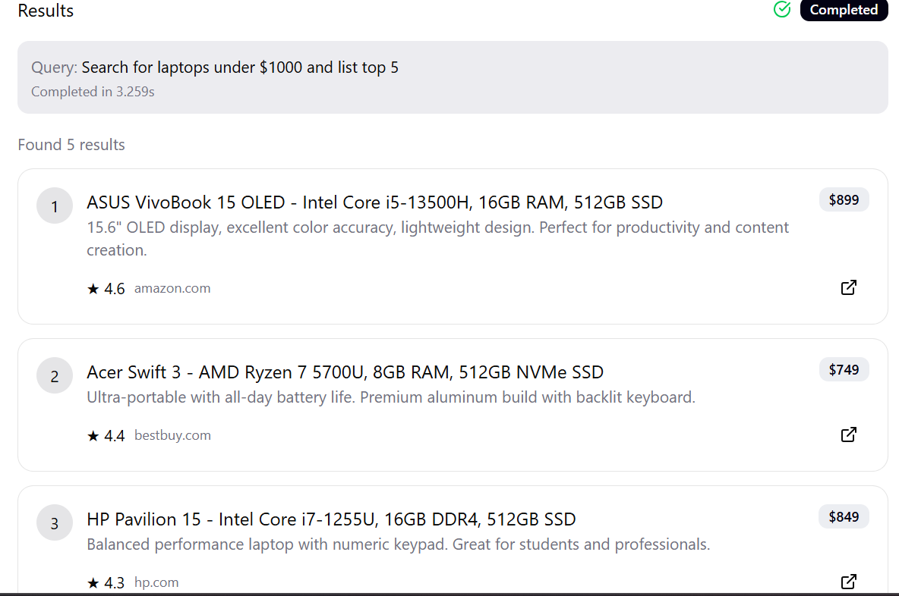

Slide 11

WebNavigator-AI-Agent
Turning web chaos into structured insights
GitHub Repository https://github.com/Webpilotai/Webpilotai
Contact
Team:harshithasri.gummalla20@email.com
Thank you for your time! Questions and feedback welcome

